Slide 1
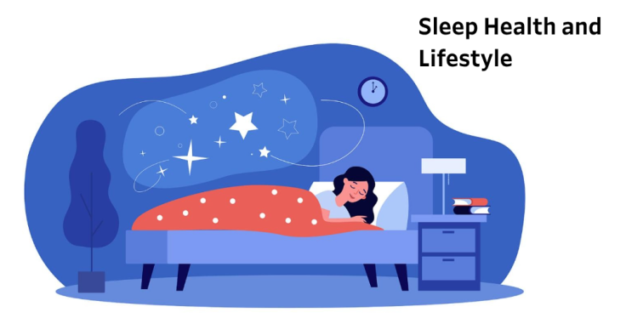
Predictive Analytics for Sleep Disorders
Identifying Health &Lifestyle Risk Factors using Machine Learning
Pavan Lade | Intern – Data Science & AI

Slide 2
Project Overview & Objectives
Objective: To analyze lifestyle factors (BMI, Blood Pressure, Occupation) and build a model that predicts whether a person has Insomnia, Sleep Apnea, or No Disorder.
The Data: 374 observations with 13 features including physical activity, stress levels, and cardiovascular metrics.

Slide 3
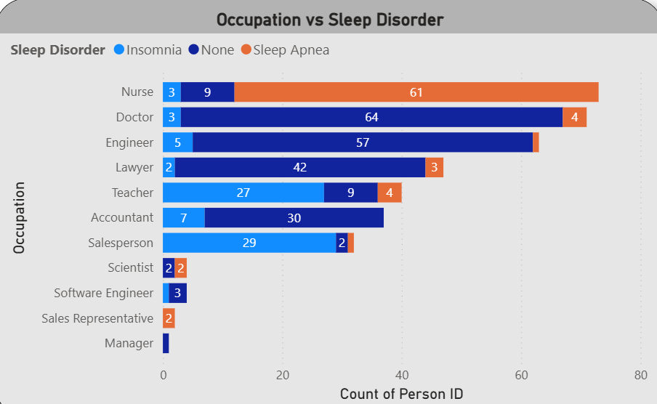
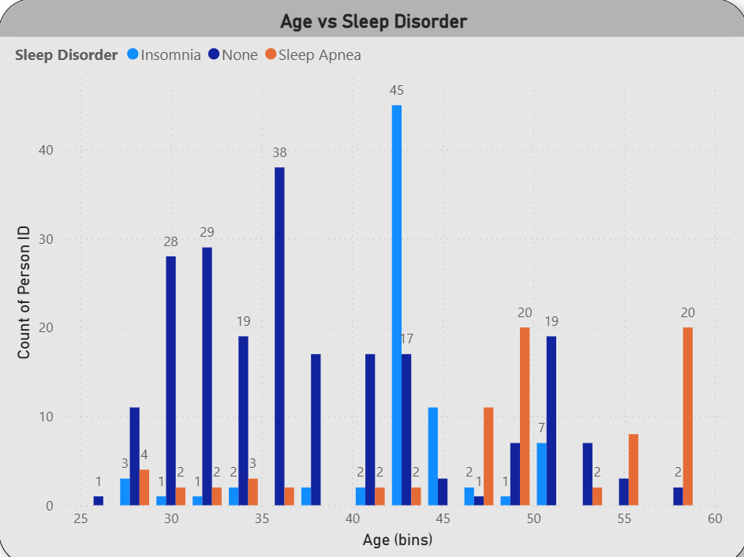
Exploratory Data Analysis (EDA)
Key Findings :
Occupational Risk: Nurses and Doctors show the highest prevalence of Sleep Apnea/Insomnia.
Age Factor: Sleep disorders significantly increase in the 45–60 age bracket.
Gender Trend: Females in this dataset show a higher concentration of Sleep Apnea compared to Males.

Slide 4
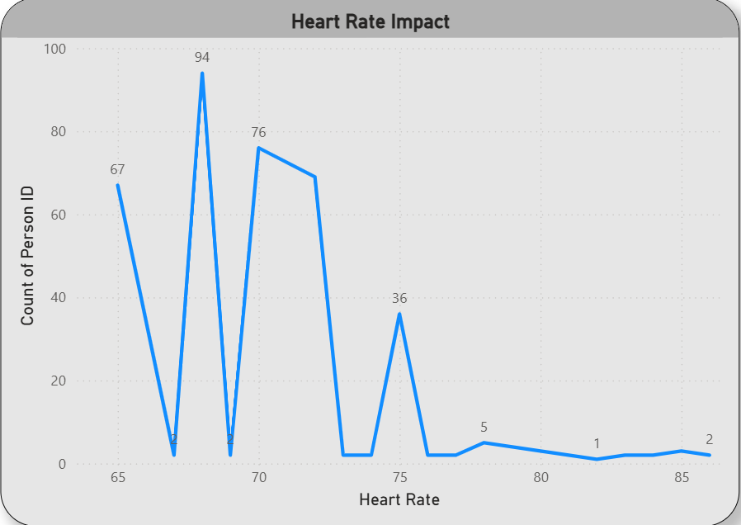
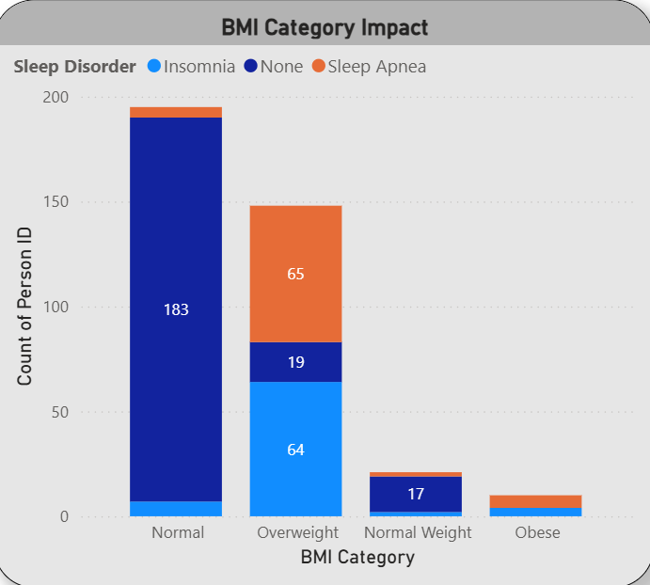
EDA – Health & Lifestyle Impact
Key Findings :
BMI Correlation : Overweight individuals have a significantly higher risk of Sleep Apnea.
Blood Pressure : High Systolic/Diastolic readings are strong precursors to sleep issues.
Heart Rate : Lower resting heart rates correlate with "None" (healthy sleep), while spikes align with disorders.

Slide 5
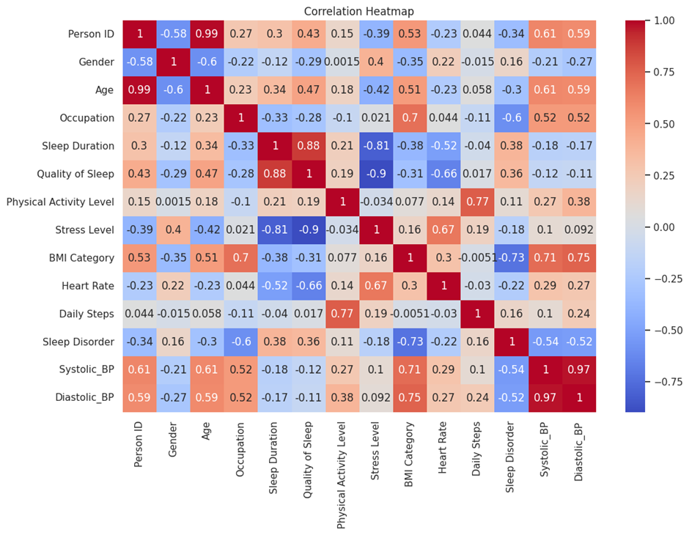
Feature Correlation Analysis
Key Findings :
Stress vs. Sleep Quality : Strong negative correlation (-0.9)—as stress rises, sleep quality collapses.
Sleep Duration vs. Quality : Strong positive correlation (0.88).
Multicollinearity : High correlation between Systolic and Diastolic BP (0.97).

Slide 6
Machine Learning Pipeline
Process Steps :
Data Cleaning: Handling missing values and encoding categorical data (Gender, BMI).
Feature Selection: Prioritizing high-impact lifestyle metrics.
Model Training: Compared Decision Tree, Random Forest, and XGBoost.

Slide 7
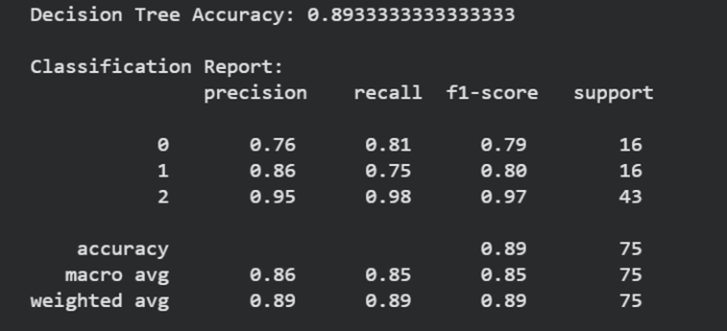
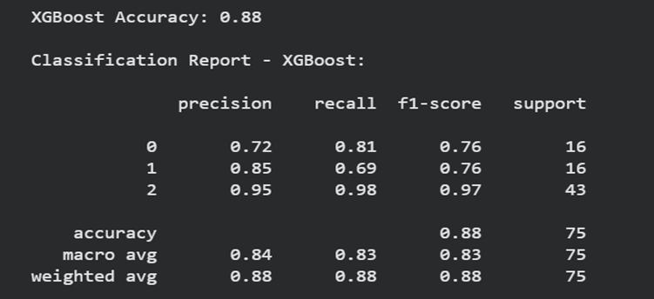
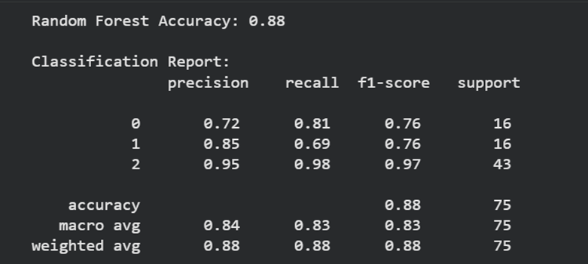
Model Comparison & Accuracy
Key Findings :
Top Performer: Decision Tree achieved the highest accuracy at 89.3%.
Consistency: Random Forest and XGBoost followed closely at 88%.
Reliability: The model is highly precise in identifying patients with No Disorder (95% Precision).

Slide 8
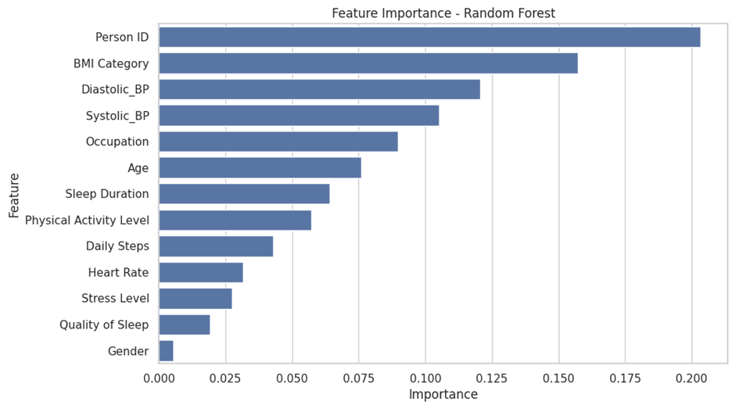
Feature Importance
Key Findings :
Primary Predictors : BMI Category and Blood Pressure are the most critical factors for prediction.
Secondary Factors : Occupation and Age play a moderate role.
Conclusion : Physical health metrics (BMI/BP) outweigh demographic metrics (Gender) in predicting sleep health.

Slide 9
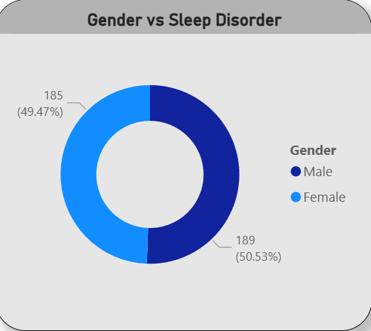
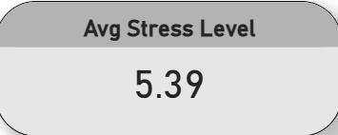
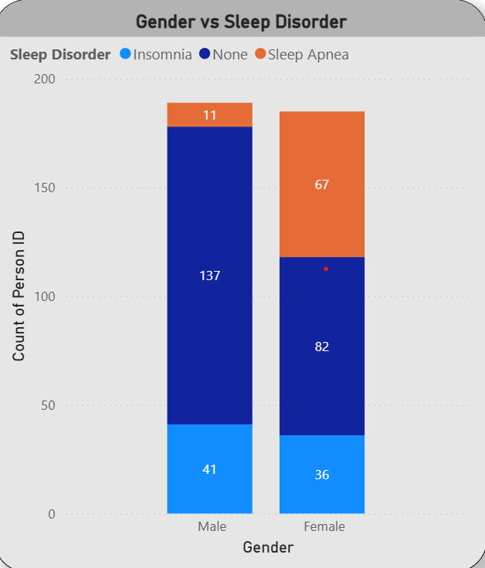
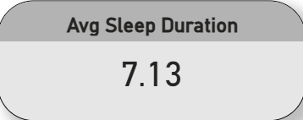
Interactive with Points of Dashboards
Real-time Filtering: Slice data by Gender or Occupation.
Key Metrics Display: Avg Sleep Duration (7.13 hrs.) and Avg Stress Level (5.39).

Slide 10
Conclusion & Recommendations
Summary : We successfully built a model with 89% accuracy to predict sleep disorders.
Recommendation : Focus health interventions on "Overweight" individuals in high-stress jobs (Nurses/Doctors).
Future Scope : Integrate data from wearable devices (Heart Rate/Steps) for real-time monitoring.

